Slide 1

DATA ENGINEERING 1
TRADEOFFS OF DATA ARCHITECTURES
Laszlo Sallo
OCTOBER 2021

Slide 2








DATA LANDSCAPE BEFORE 2010

Slide 3
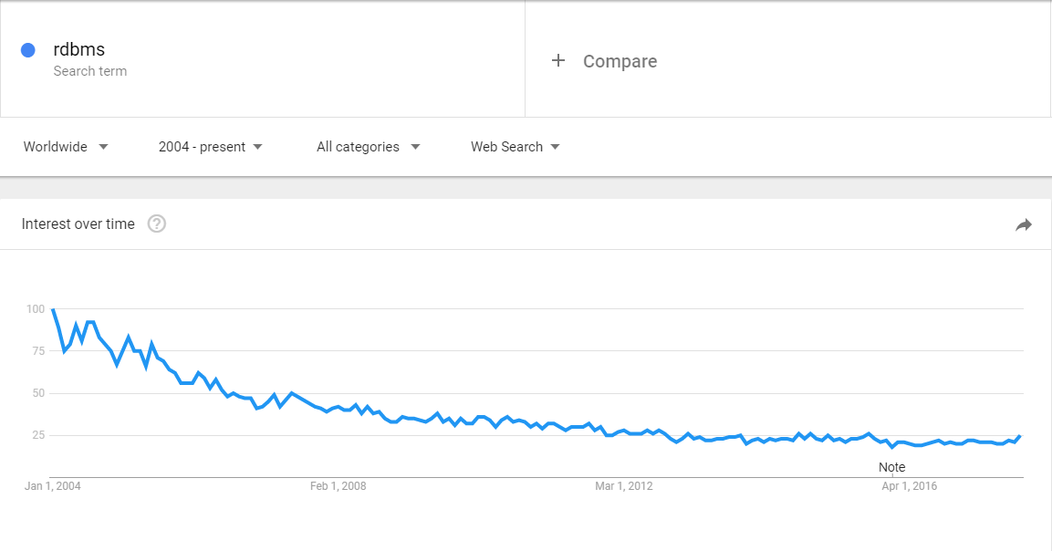
RDBMS

Slide 4
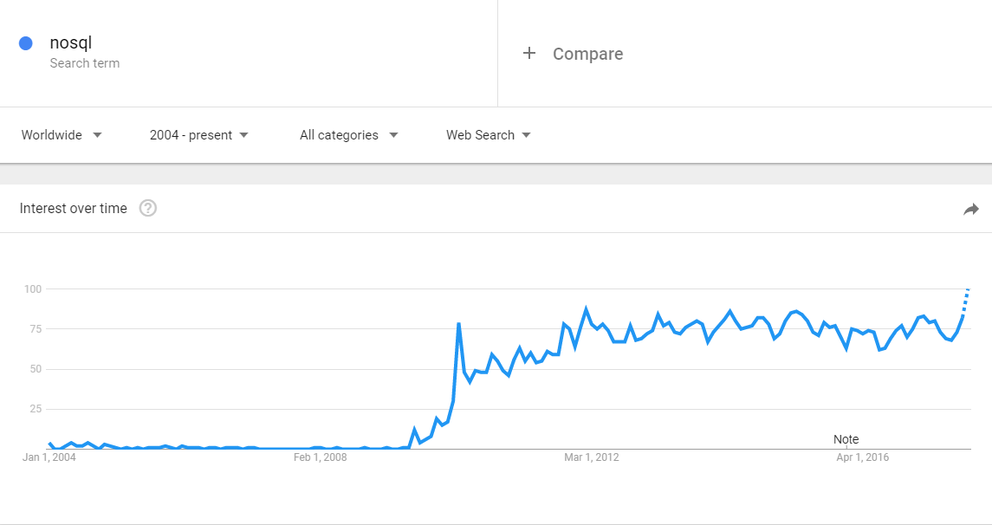
NOSQL

Slide 5
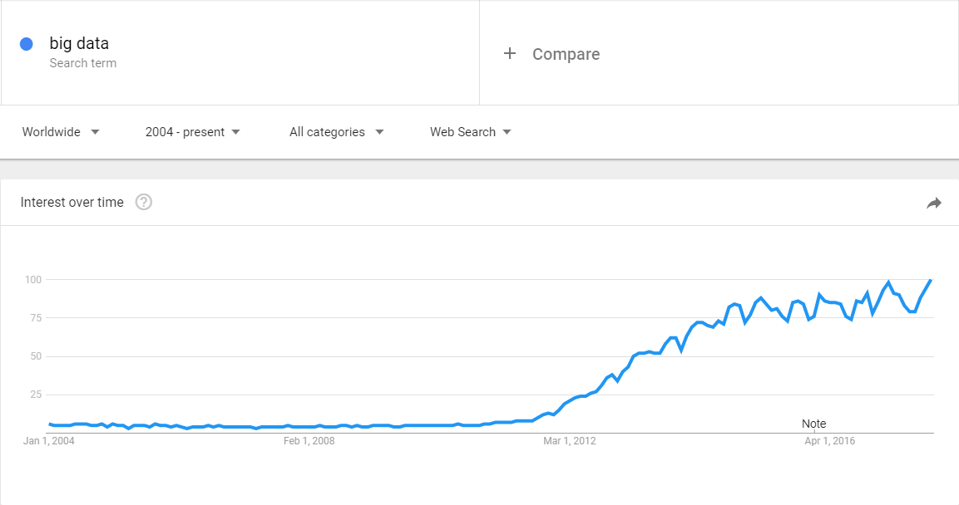
BIG DATA

Slide 6

DATA SYSTEM REVOLUTION IN LATE 2000’S

Slide 7
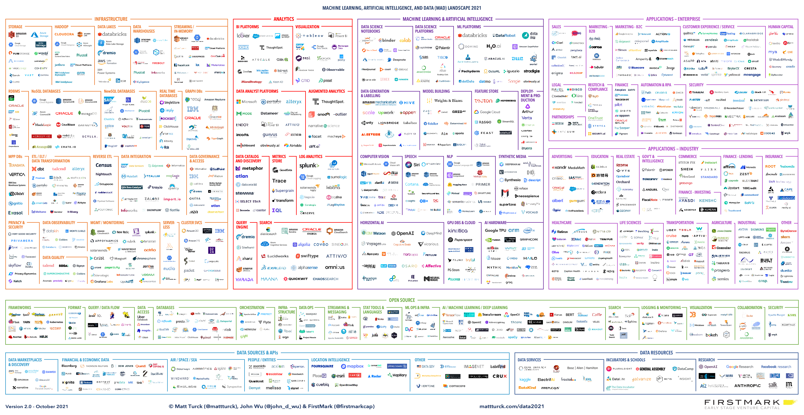

Slide 8



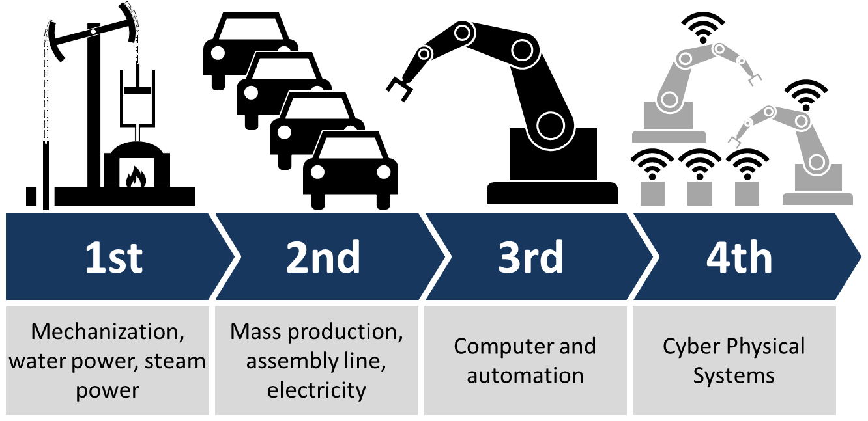
CATALYSTS OF CHANGE
SOCIAL MEDIA
MOBILITY
DIGITAL TRANSFORMATION
IoT / INDUSTRY 4.0

Slide 9

CHANGE AGENT
STARTUPS

Slide 10
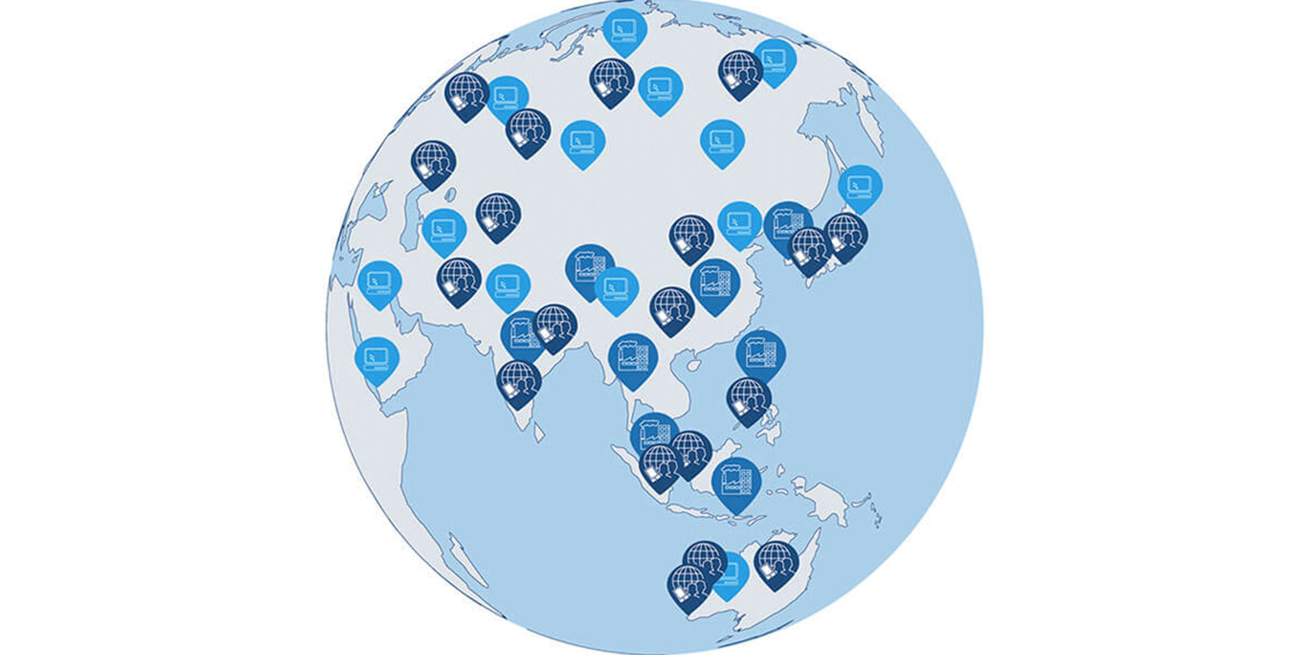
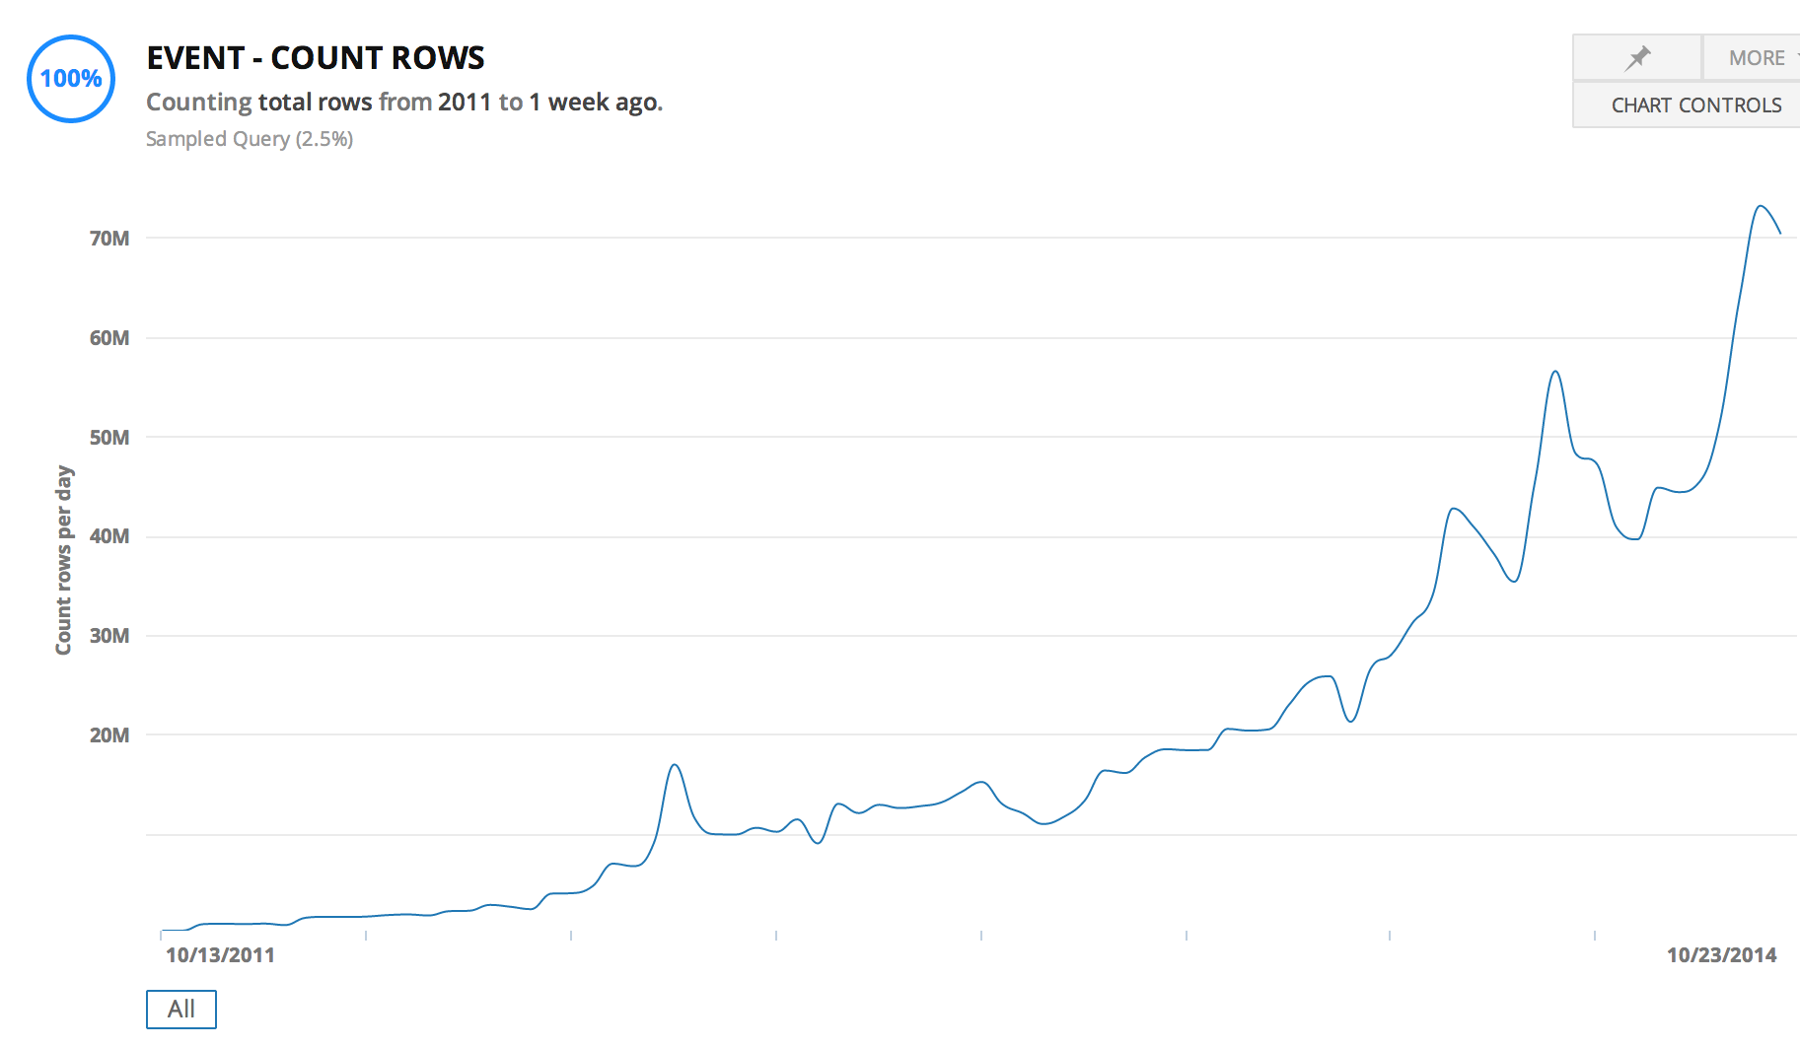

STARTUPS
GLOBAL ENTERPRISE
WITH HYPER SCALE CAPACITY

Slide 11



CHANGE AGENT
OPEN SOURCE SOFTWARE IS SOFTWARE WITH SOURCE CODE THAT ANYONE CAN
INSPECT,
MODIFY,
OR ENHANCE.

Slide 12
COST OF STORAGE / COST OF COMPUTATION
1 Gigabyte
$2.64 billion in 1965
$0.09 in 2020 (India)

Slide 13
THE CHANGE
SOLUTIONS for
real time + highly available + large DATA
in
economically feasible way
Notes:
Automated cars
Real-time bidding (RTB)
Stock exchange
Telemedicine
Blockchain

Slide 14
THE FIRST IDEA: DISTRIBUTED SYSTEMS

Slide 15


SERVER – CLIENT ARCHITECTURE
CLIENT
CLIENT
CLIENT
SERVER

Slide 16
SCALING
CLIENT
CLIENT
CLIENT
VERTICAL
SCALING
SERVER

Slide 17

DISTRIBUTED SYSTEMS
CLIENT
CLIENT
CLIENT
HORIZONTAL
SCALING
SERVER CLUSTER
NODE 1
NODE 2
NODE 3
NODE 4

Slide 18
HORIZONTAL SCALING - REPLICATION
CLIENT
CLIENT
CLIENT
REPLICATION
SCALE ONLY FOR PERFORMANCE
LOAD BALANCER
SERVER CLUSTER
COMPANY
DATA
COMPANY
DATA
COMPANY
DATA
COMPANY
DATA

Slide 19
HORIZONTAL SCALING - PARTITIONING
CLIENT
CLIENT
CLIENT
PARTITIONING
HAVE TO KNOW WHERE TO GO
UNBALANCED
PROXY
SERVER CLUSTER
COMPANY
EUROPE
DATA
COMPANY
AMERICA
DATA
COMPANY
ASIA
DATA
COMPANY
AFRICA
DATA

Slide 20
HORIZONTAL SCALING - SHARDING
CLIENT
CLIENT
CLIENT
SHARDING
CAN BE SLOW
AGGREGATOR
SERVER CLUSTER
COMPANY
DATA A
COMPANY
DATA B
COMPANY
DATA C
COMPANY
DATA D

Slide 21
BARE METAL SERVER
ISSUES
COSTLY
COMPLICATED
HARD TO SCALE

Slide 22
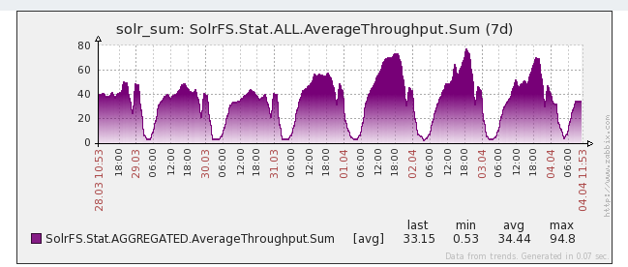
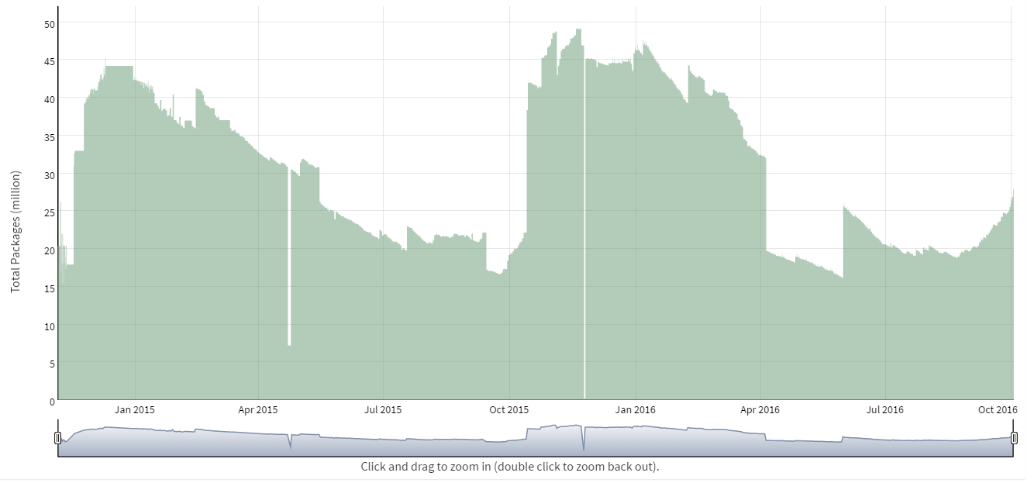
USE CASE
SEASONALITY OF REQUESTS (DAY)
SEASONALITY OF DATA SIZE (YEAR)

Slide 23
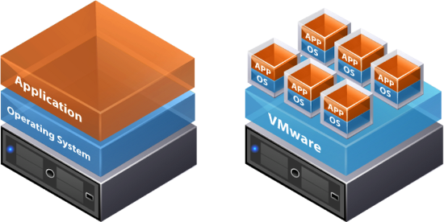
THE NEXT IDEA: TENANTS
RESOURCE RENTING (DATA CENTERS) DYNAMIC RESOURCE ALLOCATION (VIRTUALIZATION)

Slide 24
VIRTUALIZATION
ISSUES
COSTLY
COMPLICATED
HARD TO SCALE
SECURITY: PRIVATE VS PUBLIC

Slide 25

THE NEXT IDEA: CLOUD

Slide 26
USE CASE - AMAZON
…
5% utilized
NODE 1
NODE 2
NODE 3
NODE 4

Slide 27

CLOUD
2006

Slide 28
WHAT IS CLOUD?
A PIECE OF SOFTWARE WHICH OFFERS:
TOOLS TO REMOTELY AND SIMPLY HANDLE
VIRTUAL HARDWARE AND/OR SOFTWARE.

Slide 29
FURTHER BENEFITS
XAAS
IAAS – Infrastructure as a service
PAAS – Platform as a service
STAAS – Storage as a service
SAAS – Software as a service
DAAS – Database as a services
Serverless

Slide 30
CLOUD
ISSUES
COSTLY
COMPLICATED
HARD TO SCALE
SECURITY
BENEFITS
GEO SAFE
AUTOMATION
IAC (Infrastructure as code)

Slide 31
FINANCIAL CONDUCT AUTHORITY (UK)
We see no fundamental reason why cloud services (including public cloud services) cannot be implemented, with appropriate consideration, in a manner that complies with our rules.
(2016.07.07)
https://www.fca.org.uk/publications/finalised-guidance/fg16-5-guidance-firms-outsourcing-%E2%80%98cloud%E2%80%99-and-other-third-party-it

Slide 32



CLOUD PROVIDERS

Slide 33

THE NEXT IDEA: BUILD NEW TOOLS

Slide 34
RDBMS IN A NEW PERSPECTIVE
RDBMS
= DESIGNED FOR OPERATIONS
= DESIGNED TO BE PERFECT IN EVERY SITUATION

Slide 35
CHARACTERISTICS OF RDBMS
Consistency is always guaranteed
Consistency over availability
Fully available or not available at all
…
FOR MORE READ ABOUT: ACID & CAP
Notes:
Consistency: Availability correlates with revenue and consistency generally does not.
Availability: partial availably ?
100% PERFECT
= $$$$$

Slide 36

DO WE REALLY NEED RDBMS PERFECTION?

Slide 37
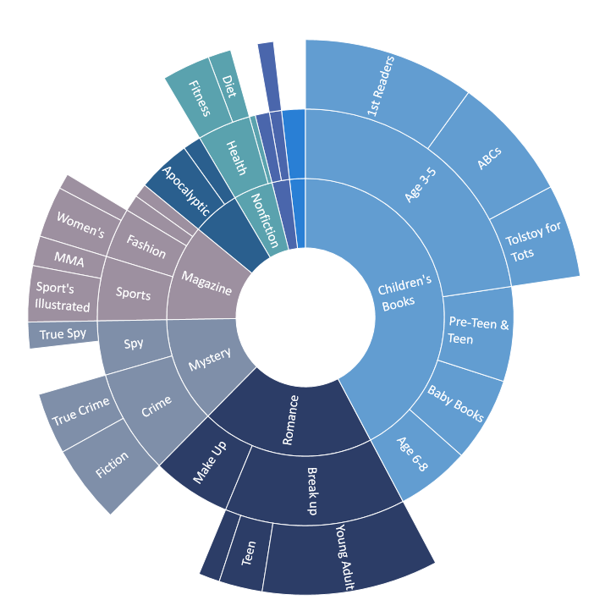
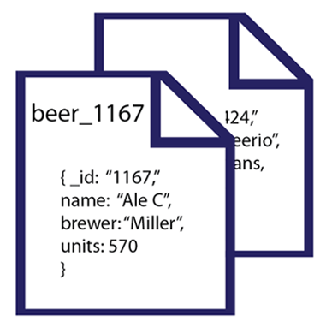
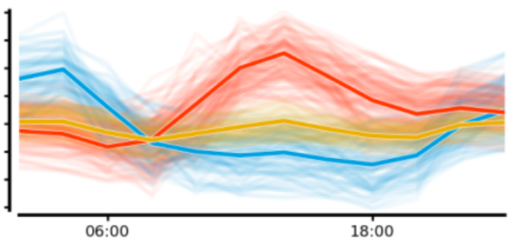
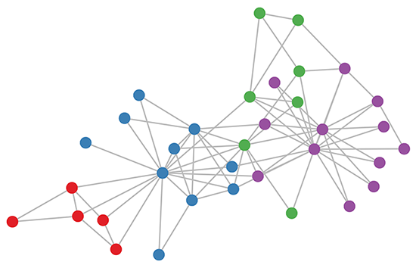
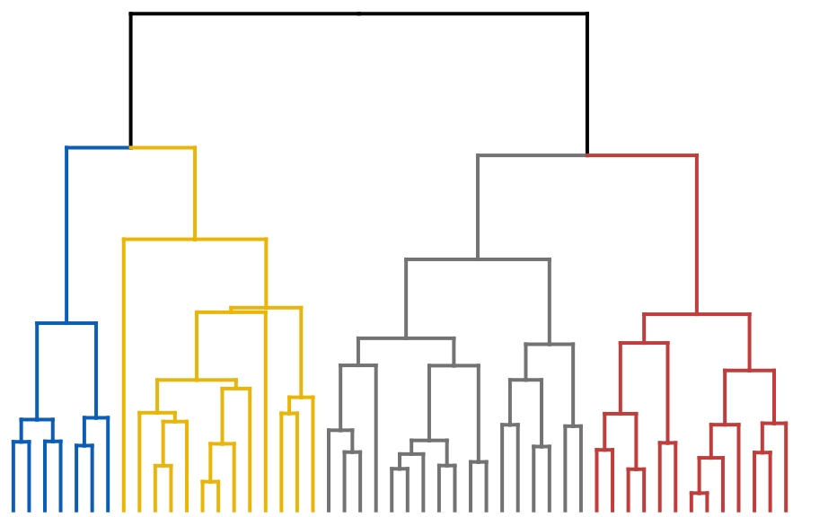
CAN WE GO BEYOND TABULAR DATA?

Slide 38
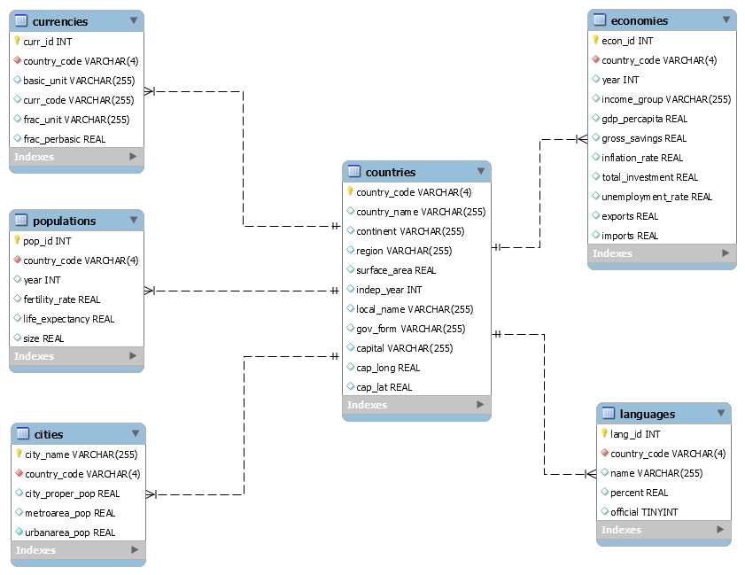
DO WE NEED THOSE RIGID SCHEMAS?

Slide 39


SPECIALIZED
NEW TOOLS
RDBMS

Slide 40
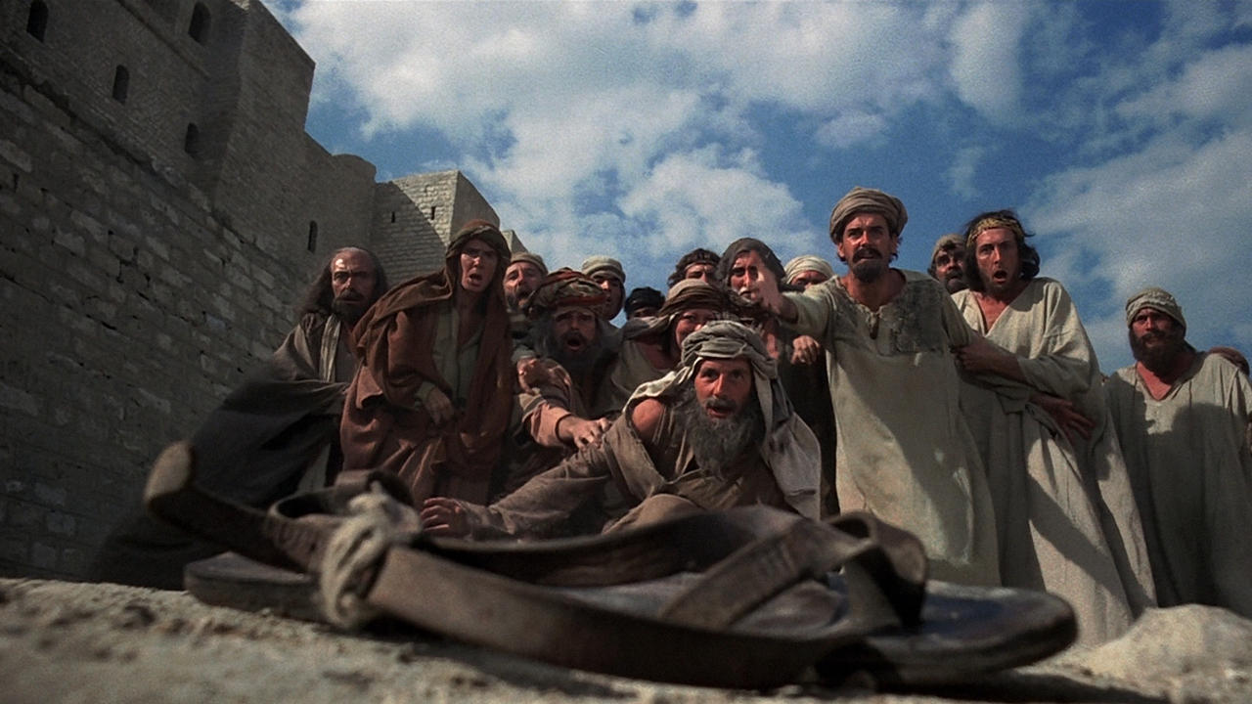
BIG DATA, NOSQL, …

Slide 41

NOSQL

Slide 42
INTEGRITY AND CONSISTENCY
BASICALLY AVAILABLE
SOFT STATE
EVENTUAL CONSISTENCY
BASE

Slide 43
INTERFACE
SQL
ActionScript Bash C C# C++ Clojure Common Lisp Crystal D Dart Delphi Elixir emacs lisp Erlang Fancy gawk GNU Prolog Go Haskell Haxe Io Java Julia Lasso Lua Matlab mruby Nim Node.js Objective-C OCaml Pascal Perl PHP PL/SQL Pure Data Python R Racket Rebol Ruby Rust Scala Scheme Smalltalk Swift Tcl VB VCL Xojo …

Slide 44

SCHEMALESS OR SCHEMA FREE
A SMART DATABASE CAN FIGURE OUT
THE DATATYPE
THE STRUCTURE

Slide 45
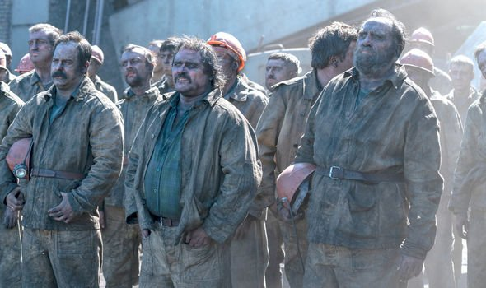
ALGORITHMS DEEP IN THE DATABASE
NO NEED TO MINE

Slide 46

MADE FOR CLOUD

Slide 47
NOSQL CLASSIFICATION
KEY-VALUE STORES
TIME SERIES DBMS
DOCUMENT STORES
COLUMN STORES
SEARCH ENGINES
GRAPH DBMS
100s
OF NOSQL
SOLUTIONS

Slide 48
DB-ENGINES.COM
YOUR ULTIMATE SOURCE TO
EXPLORE
http://db-engines.com/en/system/MySQL
http://db-engines.com/en/system/Elasticsearch
CATEGORIZE / KNOW THE TRENDS
http://db-engines.com/en/ranking_categories
http://db-engines.com/en/ranking_osvsc
http://db-engines.com/en/ranking_trend
COMPARE
http://db-engines.com/en/system/Elasticsearch%3BMongoDB

Slide 49
THE NEW TOOLS
NOSQL
SET OF SOLUTIONS
PERFORMANCE ORIENTED
DATABASE
OPERATIONAL AND ANALYTICAL
STRUCTURED/ SEMI-STRUCTURED
BIG DATA
SET OF SOLUTIONS
DATA VOLUME ORIENTED
DATA FRAMEWORK
ANALYTICAL
MAINLY UNSTRUCTURED

Slide 50
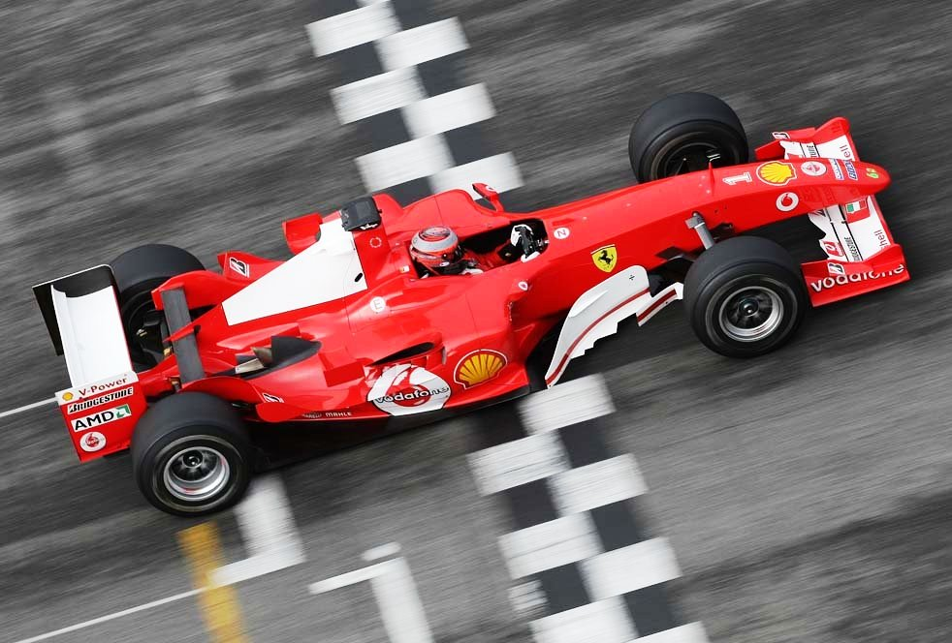
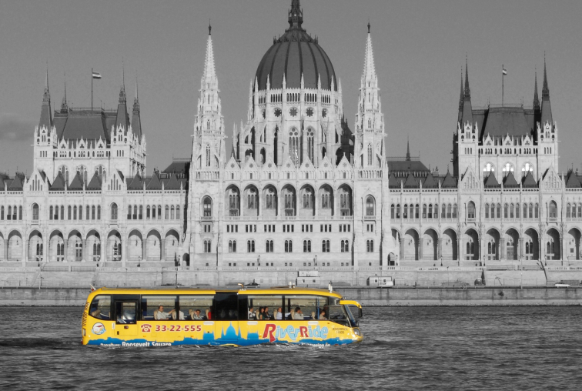
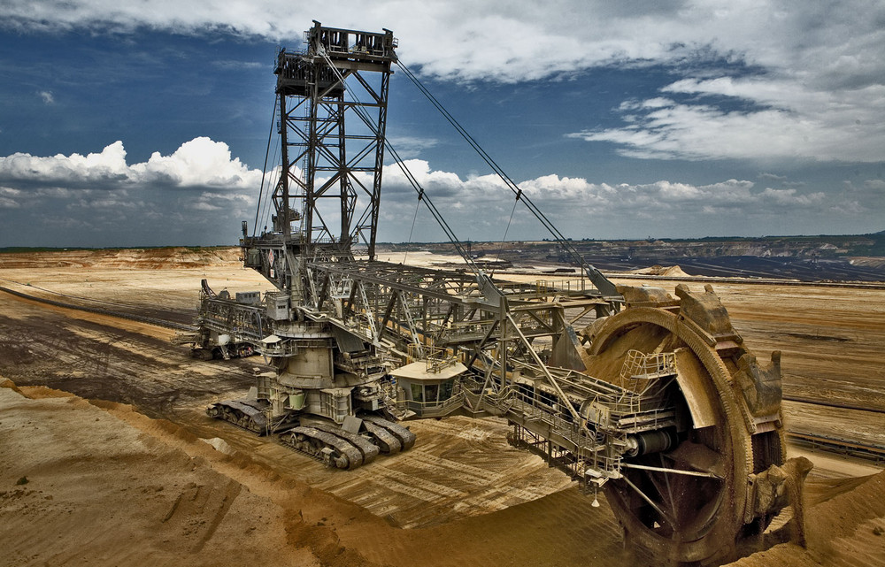
GAME
WHICH ONE YOU
WOULD ASSOCIATE
WITH
RDBMS,
NOSQL,
BIGDATA ?
1
2
3

Slide 51
NOSQL CLASSIFICATION
KEY-VALUE STORES
TIME SERIES DBMS
DOCUMENT STORES
COLUMN STORES
SEARCH ENGINES
GRAPH DBMS

Slide 52
KEY-VALUE DATA FORM - EXAMPLES
key | value
1 | John
2 | Mary
3 | Peter
key | value
War and Peace | ‘Well, Prince, so Genoa and Lucca are now just family …”
The Master and Margarita | “At the sunset hour of one warm spring day two men were to be seen …”
The Winter of Our Discontent | “I wonder how many people I've looked at all my life and never seen.”

Slide 53
KEY-VALUE STORE FEATURES
SIMPLEST DBMS VARIANT
EASY TO SCALE
HIGH PERFORMANCE (MANY TIMES IN MEMORY)

Slide 54
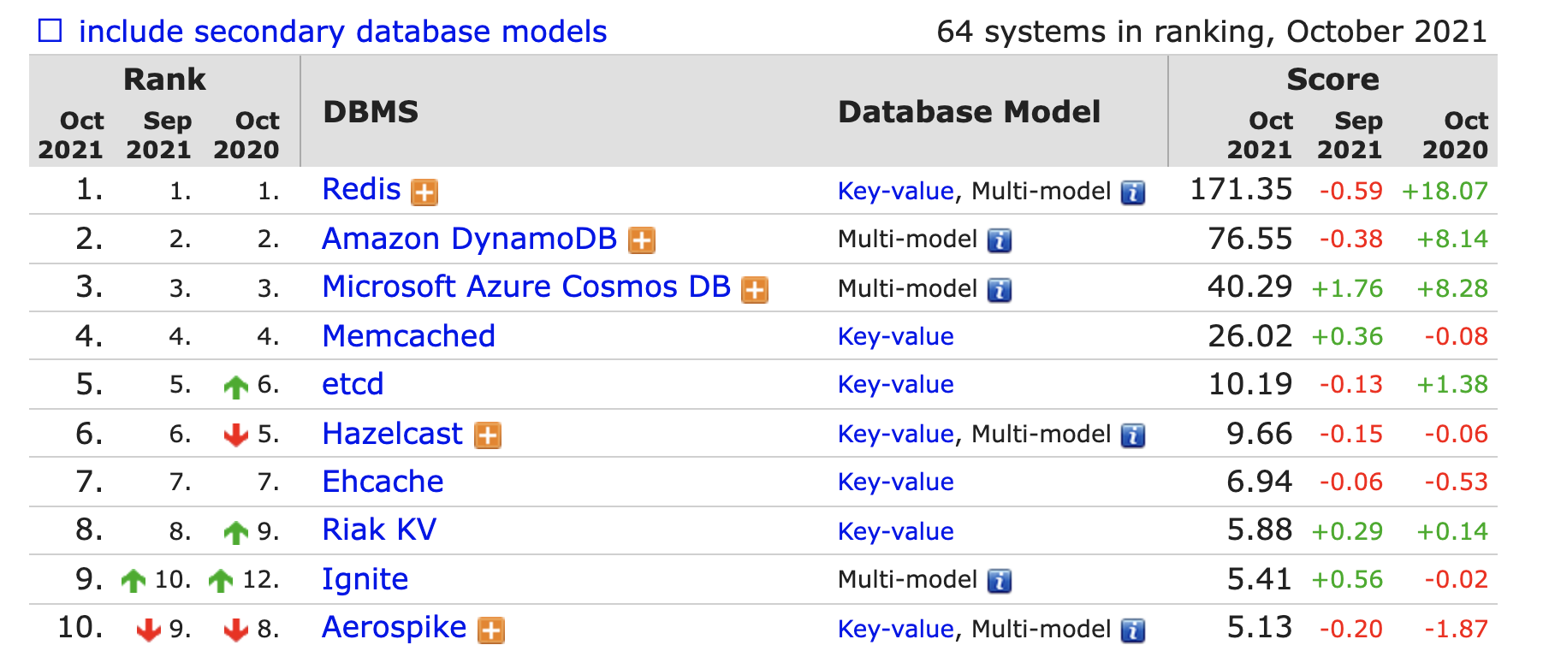
KEY-VALUE STORE RANK

Slide 55






REDIS IN CLOUD

Slide 56
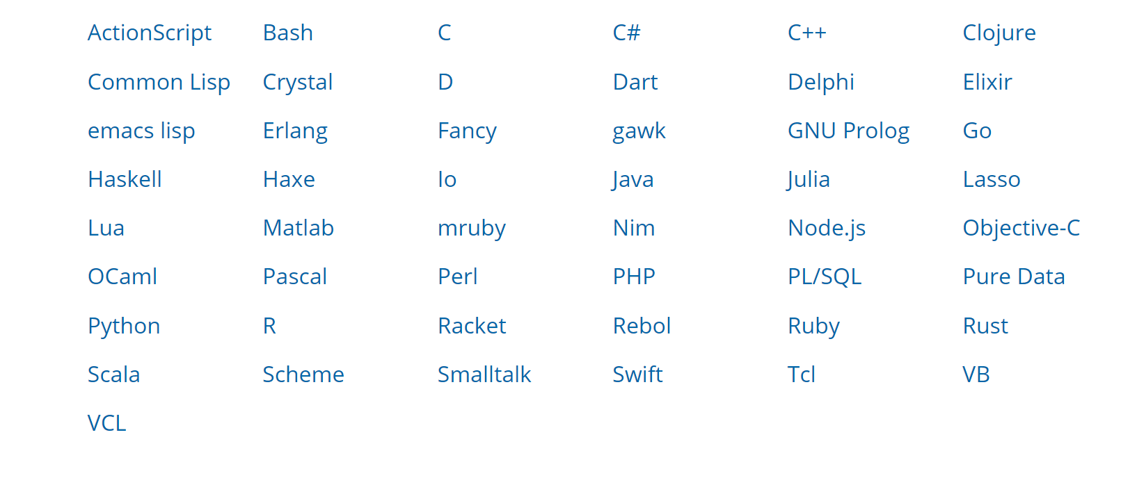
ACCESS REDIS

Slide 57
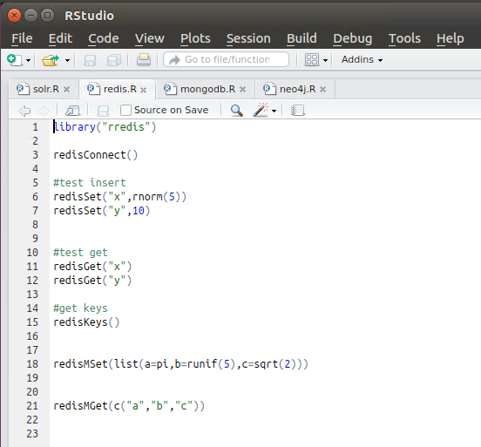
R STUDIO

Slide 58
NOSQL CLASSIFICATION
KEY-VALUE STORES
TIME SERIES DBMS
DOCUMENT STORES
COLUMN STORES
SEARCH ENGINES
GRAPH DBMS

Slide 59
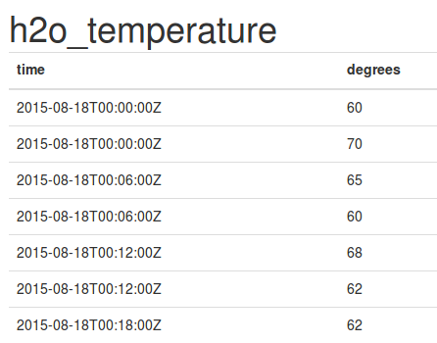
TIME SERIES DBMS
KEY: TIME
VALUE: TIME SERIES DATA (MEASUREMENT, EVENT ETC)

Slide 60
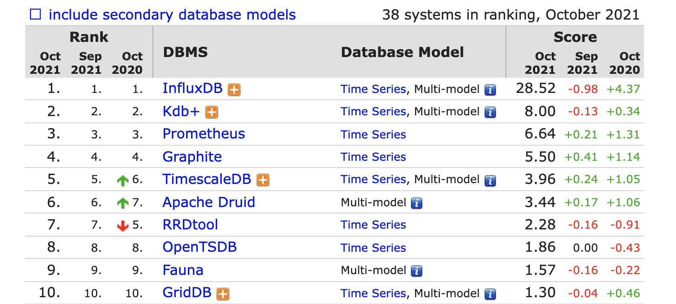
TIME SERIES DBMS

Slide 61
TIME SERIES DBMS - FEATURES
QUERY BY TIME
HIGH PERFORMING WRITE
STATISTICAL OPERATION ON TIME SERIES
DOWN SAMPLING AND DATA RETENTION

Slide 62
INFLUX DB FUNCTIONS
Aggregations | Selectors | Transformations | Predictors | Technical Analysis
COUNT() | BOTTOM() | ABS() | HOLT_WINTERS() | CHANDE_MOMENTUM_OSCILLATOR()
DISTINCT() | FIRST() | ACOS() |  | EXPONENTIAL_MOVING_AVERAGE()
INTEGRAL() | LAST() | ASIN() |  | DOUBLE_EXPONENTIAL_MOVING_AVERAGE()
MEAN() | MAX() | ATAN() |  | KAUFMANS_EFFICIENCY_RATIO()
MEDIAN() | MIN() | ATAN2() |  | KAUFMANS_ADAPTIVE_MOVING_AVERAGE()
MODE() | PERCENTILE() | CEIL() |  | TRIPLE_EXPONENTIAL_MOVING_AVERAGE()
SPREAD() | SAMPLE() | COS() |  | TRIPLE_EXPONENTIAL_DERIVATIVE()
STDDEV() | TOP() | CUMULATIVE_SUM() |  | RELATIVE_STRENGTH_INDEX()
SUM() |  | DERIVATIVE()
 |  | DIFFERENCE()
 |  | ELAPSED()
 |  | EXP()
 |  | FLOOR()
 |  | HISTOGRAM()
 |  | LN()
 |  | LOG()
 |  | LOG2()
 |  | LOG10()
 |  | MOVING_AVERAGE()
 |  | NON_NEGATIVE_DERIVATIVE()
 |  | NON_NEGATIVE_DIFFERENCE()
 |  | POW()
 |  | ROUND()
 |  | SIN()
 |  | SQRT()
 |  | TAN()

Slide 63
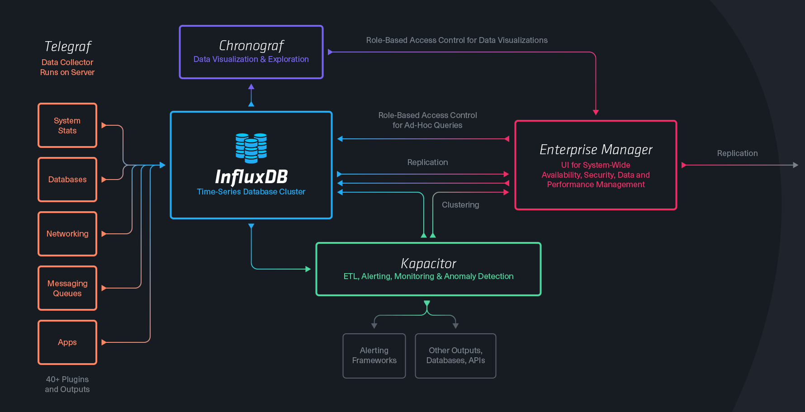

INFLUX TICK STACK

Slide 64

USE CASE EXAMPLE
VISUALIZE
IoT
Metrics Influx
(Aggregate)
PROCESSOR
SENSORS
Event Influx
(Interpret)
QUEUE
PROCESSOR
KEY VALUE
MONITOR

Slide 65
USE CASES
IOT
SYSTEM / INFRASTRUCTURE MONITORING
SMART CITY
INDUSTRY 4.0
ANOMALY DETECTION
TRADING DATA

Slide 66

REDIS PRACTICE WITH ZEPPELIN NOTEBOOK

Slide 67
NOSQL CLASSIFICATION
KEY-VALUE STORES
TIME SERIES DBMS
DOCUMENT STORES
COLUMN STORES
SEARCH ENGINES
GRAPH DBMS

Slide 68
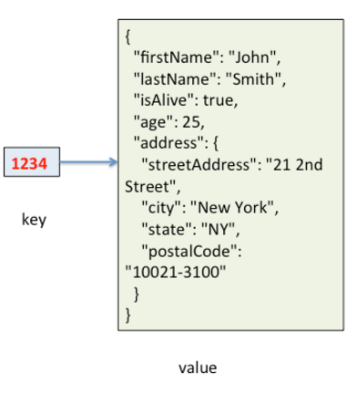
DOCUMENT STORES
KEY: ID
VALUE: QUERYABLE STRUCTURED DOCUMENT

Slide 69
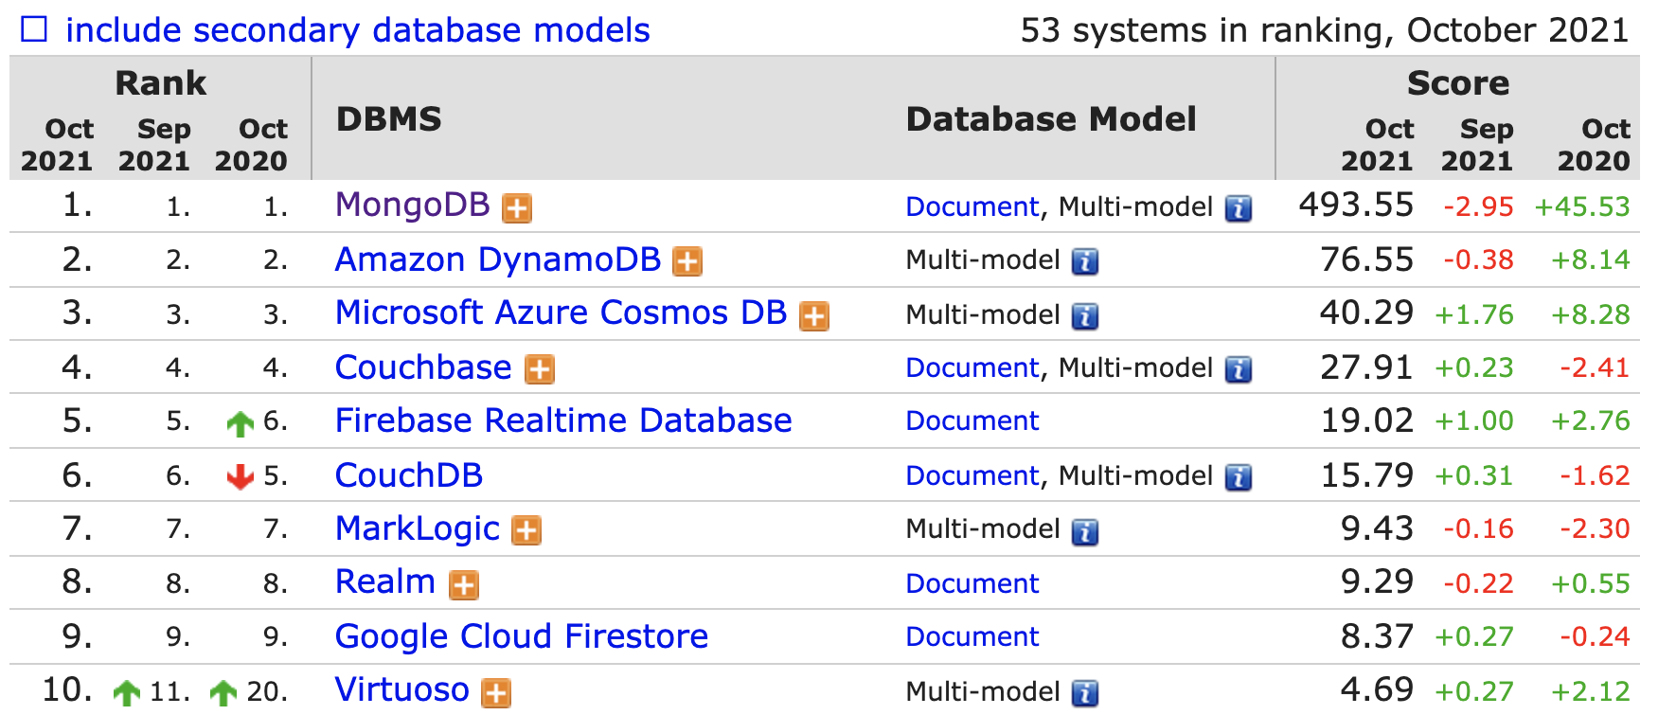
DOCUMENT STORES

Slide 70
MONGODB
THE MOST USED NOSQL
CLOSER TO GENERAL PURPOSE / SLOWER
HIGH AVAILABILITY / AUTOMATIC FAILOVER
HIGHLY SCALABLE / REBALANCING
SELECTABLE CONSISTENCY
NO TRANSACTION SUPPORT
DYNAMIC SCHEMA

Slide 71
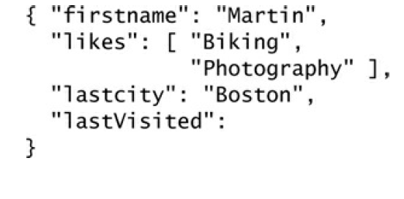
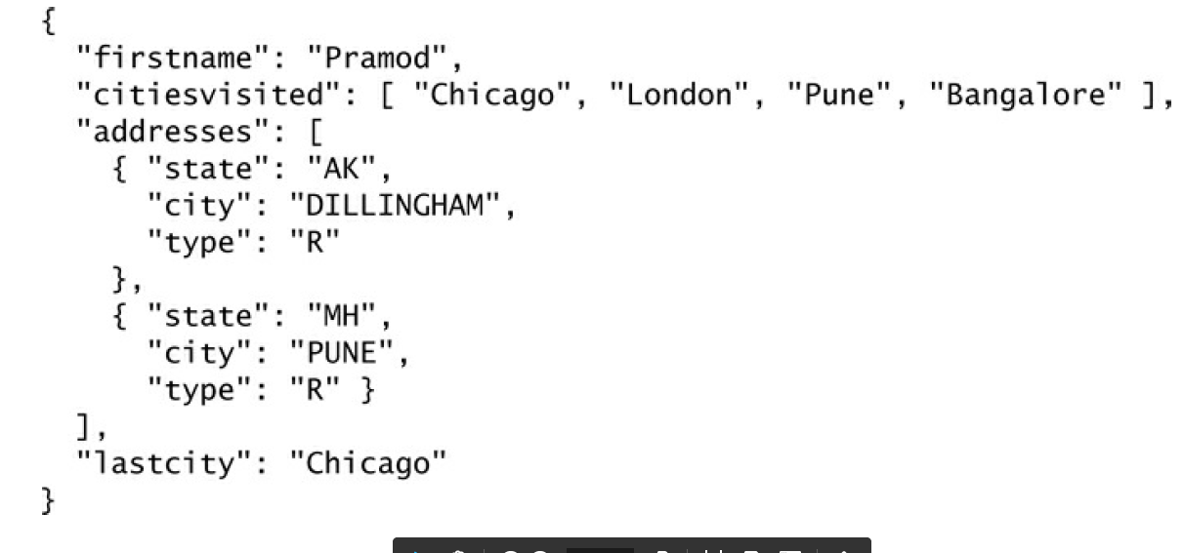
DYNAMIC SCHEMA
BE CAREFUL!

Slide 72
TERMINOLOGY
SQL SERVER | MONGODB
Database | Database
Table | Collection
Index | Index
Row | Document
Column | Field
Joining | Linking & Embedding
Partition | Sharding

Slide 73




MONGO ACCESS
BI TOOLS
PROGRAMING LANGUAGES

Slide 74


USAGE
WHEN YOU WANT TO STORE/QUERY HIGH VOLUME OF MULTIDIMENSIONAL DATA
AND
FAILOVER, HIGH AVAILABILITY AND CONSISTENCY MATTERS FOR YOU
USE CASES: https://www.mongodb.com/industries/

Slide 75
USAGE
DO NOT USE WHEN
MONGO CAN’T HANDLE YOUR DATA SIZE
YOU NEED TRANSACTIONS
YOU NEED COMPLEX AGGREGATIONS
YOU HAVE COMPLEX RELATIONS

Slide 76

MONGO PRACTICE

